Slide 1
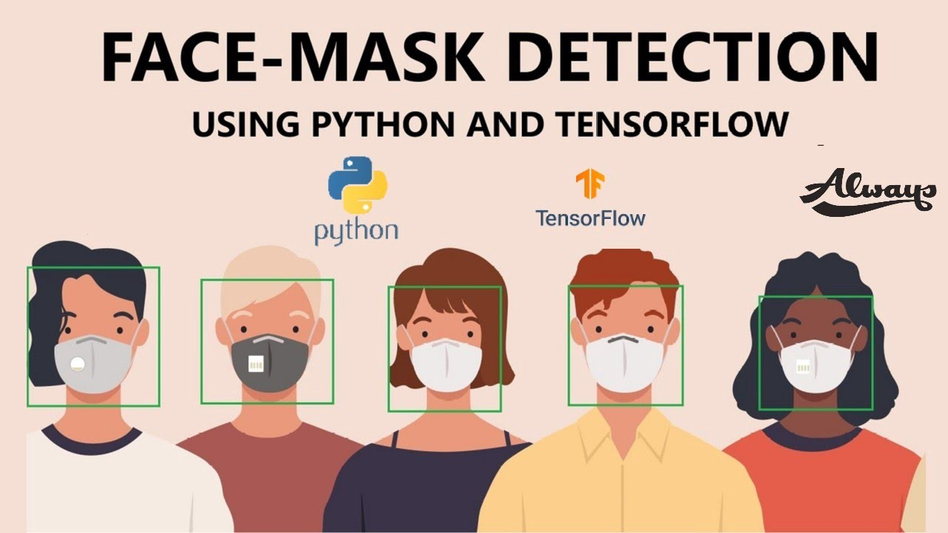
Face Mask Recognition System
Under Guidance of :
Dr. Saroj Bala ( aJAY KUMAR GARG ENGINEERING COLLEGE )

Slide 2
Group Members and their roles
Krashn Tripathi - Data Collection
Rishabh Maheshwari - Model Evaluation and Plotting graph
Shefali Manshani - Face Mask Detection on Live WebCam
Shivam Singh - Training base model using MobileNetv2
Vicky Kumar - Front End

Slide 3
Introduction
Face Mask Detection System is based on computer vision and deep learning. The proposed model can be integrated with Surveillance Cameras to impede the COVID-19 transmission by allowing the detection of people who are wearing masks not wearing face masks. The model is integration between deep learning and classical machine learning techniques with Open CV, Tensor flow and Keras.

Slide 4
Software Used
Programming Language : Python (version 3.7)
Python IDE :
Back End : Visual Studio Code
Front End : Jupyter Notebook

Slide 5
Programming Language : Python
Python is a high-level, general-purpose and a very popular programming language. Python programming language (latest Python 3) is being used in web development, Machine Learning applications, along with all cutting edge technology in Software Industry. Python Programming Language is very well suited for Beginners, also for experienced programmers with other programming languages like C++ and Java.
Below are some facts about Python Programming Language:
Python is currently the most widely used multi-purpose, high-level programming language.
Python allows programming in Object-Oriented and Procedural paradigms.
Python programs generally are smaller than other programming languages like Java. Programmers have to type relatively less and indentation requirement of the language, makes them readable all the time.
Python language is being used by almost all tech-giant companies like – Google, Amazon, Facebook, Instagram, Uber… etc.
The biggest strength of Python is huge collection of standard library which can be used for the following:
Machine Learning
GUI Applications (like Kivy, Tkinter, PyQt etc. )
Web frameworks like Django (used by YouTube, Instagram, Dropbox)
Image processing (like OpenCV, Pillow)
Web scraping (like Scrapy, BeautifulSoup, Selenium)
Text processing and many more..

Slide 6
Frameworks & Libraries Used
Tensorflow :
TensorFlow is a free and open-source software library for machine learning and artificial intelligence.
OpenCV :
OpenCV is a library of programming functions mainly aimed at real-time computer vision.
Keras :
Keras is an open-source software library that acts as an interface for the TensorFlow library.
MobileNetV2 :
MobileNetV2 is a powerful image classification tool. TensorFlow provides the image weights in MobileNetV2, a lightweight CNN-based deep learning model.
Voila :
Voilà turns Jupyter notebooks into standalone applications.

Slide 7
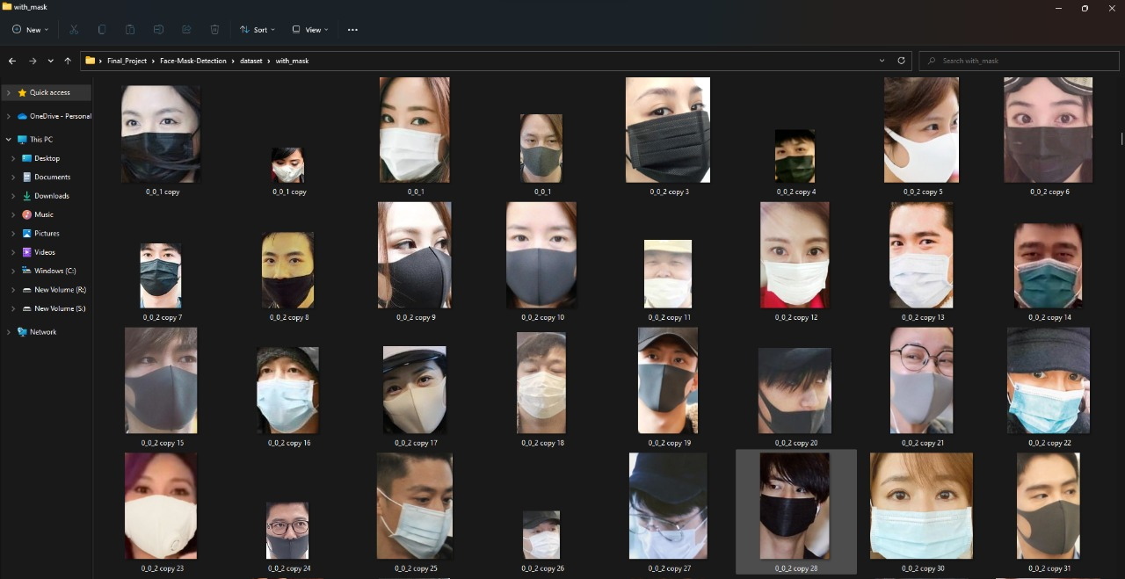
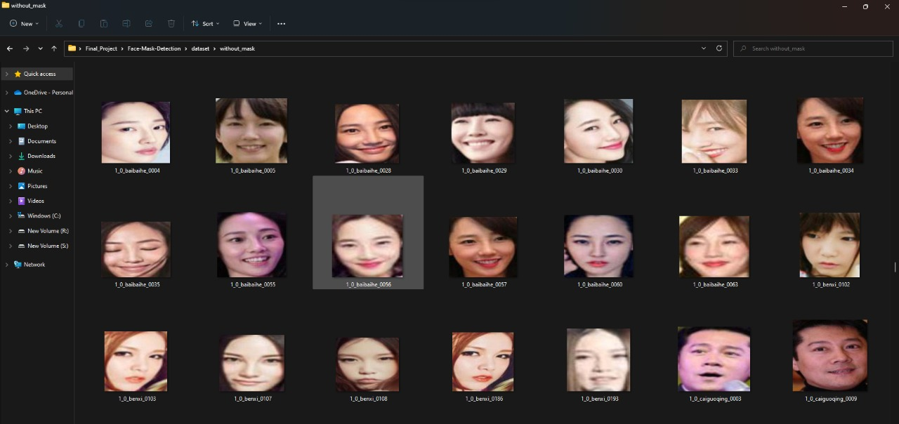
Data Collection & Image Preprocessing
Dataset has been taken from Kaggle that contains pictures of faces.
It includes two folders:
With mask (1900+ images )
Without mask ( 1900+ images )

Slide 8
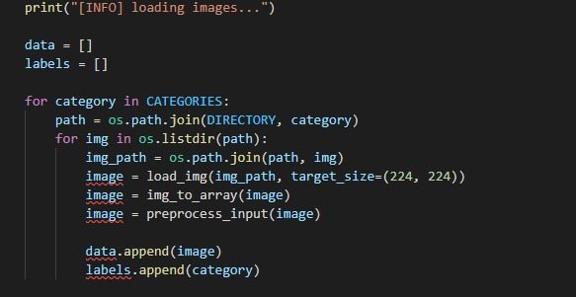
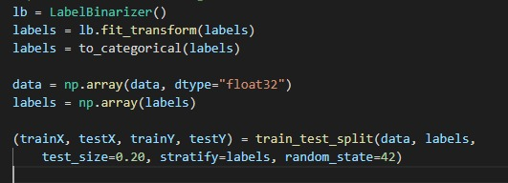
Code Snippet

Slide 9
Training base model using MobileNetV2
MobileNetV2 is a powerful image classification tool. The model analyzes the data and extracts the most relevant features from our images. There are 19 bottleneck layers in MobileNetV2. In the Base Model, we used OpenCV to detect the face and mask from images and real time video stream, OpenCV's Caffe Model is used. It allows for faster and more accurate detection of masks in video streaming.

Slide 10
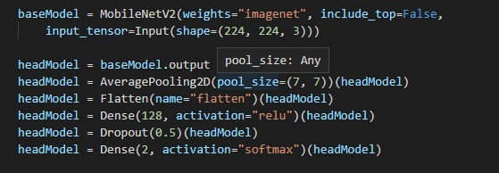
Code Snippet

Slide 11
Functions used on Proposed Model
Average Pooling : Average Pooling returns the average of all the values from the portion of the image covered by the Kernel.
Flatten : The flatten () function is used to get a copy of a given array collapsed into one dimension.
Dense : A Dense layer feeds all outputs from the previous layer to all its neurons, each neuron providing one output to the next layer.
Dropout : The term "dropout" is used for a technique which drops out some nodes of the network.
ReLU (Rectified Linear Unit) Activation Function : The ReLU is the most used activation function in the world right now. It is almost used in CNN. R (z) =max (0, z)
Range [0, ∞)
The function and its derivative both are monotonic.

Slide 12
Model Evaluation and Plotting Graph
Model Evaluation:
The evaluation model is trained for 20 Epochs each containing 95 data elements. The model is evaluated on different metrics such as Accuracy, Precision, Recall, F1-score, Macro Average and Weighted Average. During the Model Evaluation significant improvement is observed over loss, accuracy, value loss and value accuracy.
Accuracy : Accuracy is a measure of total correctly identified samples out of all the samples.
Precision : Precision means to determine the number of positive class predictions that actually belong to the positive class.
Recall : Recall means to determine the number of positive class predictions made out of all positive samples in the dataset.
F1-score : F1- Score is the average mean of Precision and Recall.
Graph Plotted :
Here the results from evaluation model are plotted and stored in a graphical format twice using the Python library matplotlib.pyplot and improvement upon training model once versus training the model twice is clearly observable to us.

Slide 13
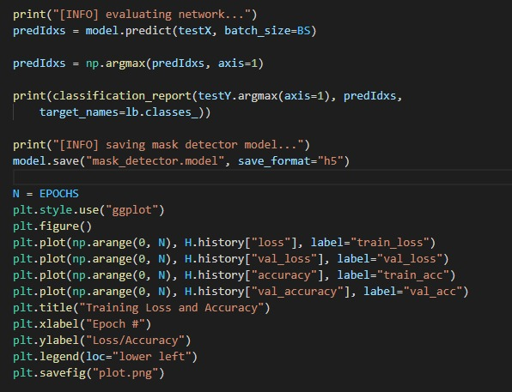
Code Snippet

Slide 14
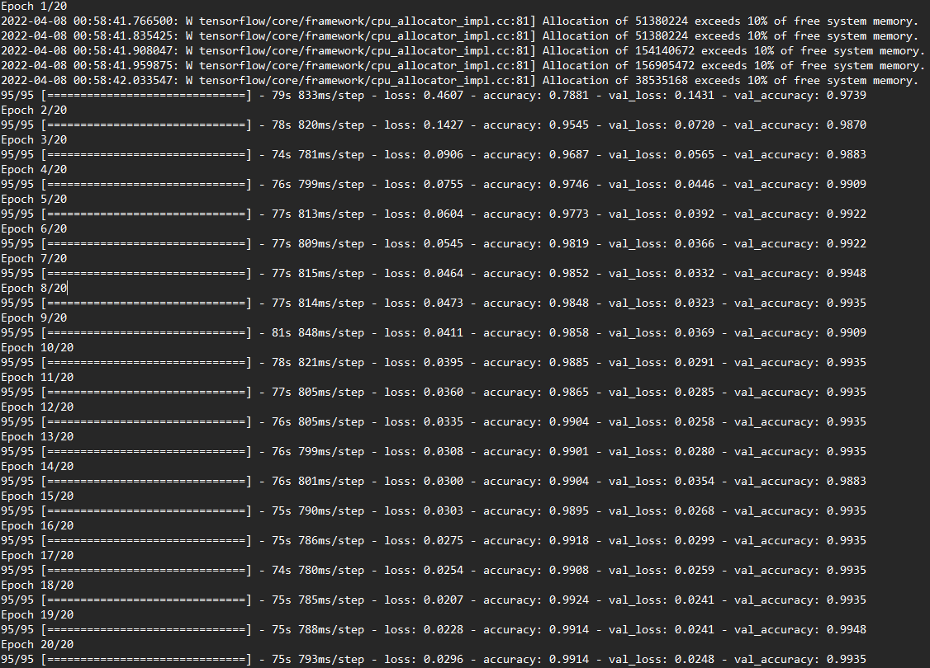
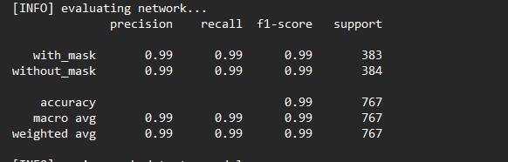
Model Evaluation
Click to add
Fig : Classification Report
Fig : Model Evaluated for 20 Epochs

Slide 15
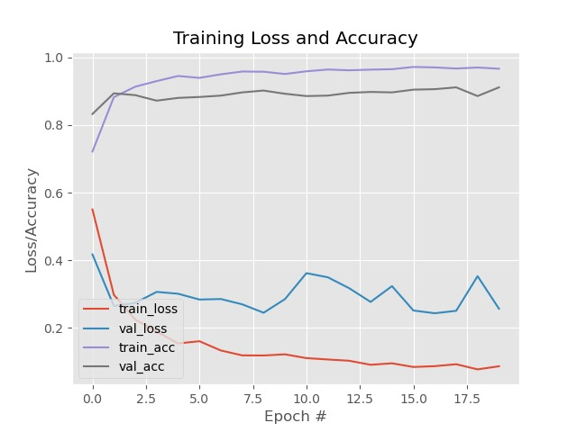
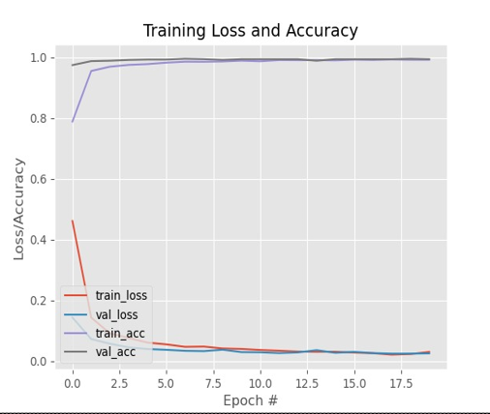
Graph Plotted
Fig : Graph of Model Trained 1st time
Fig : Graph of Model Trained 2nd time

Slide 16
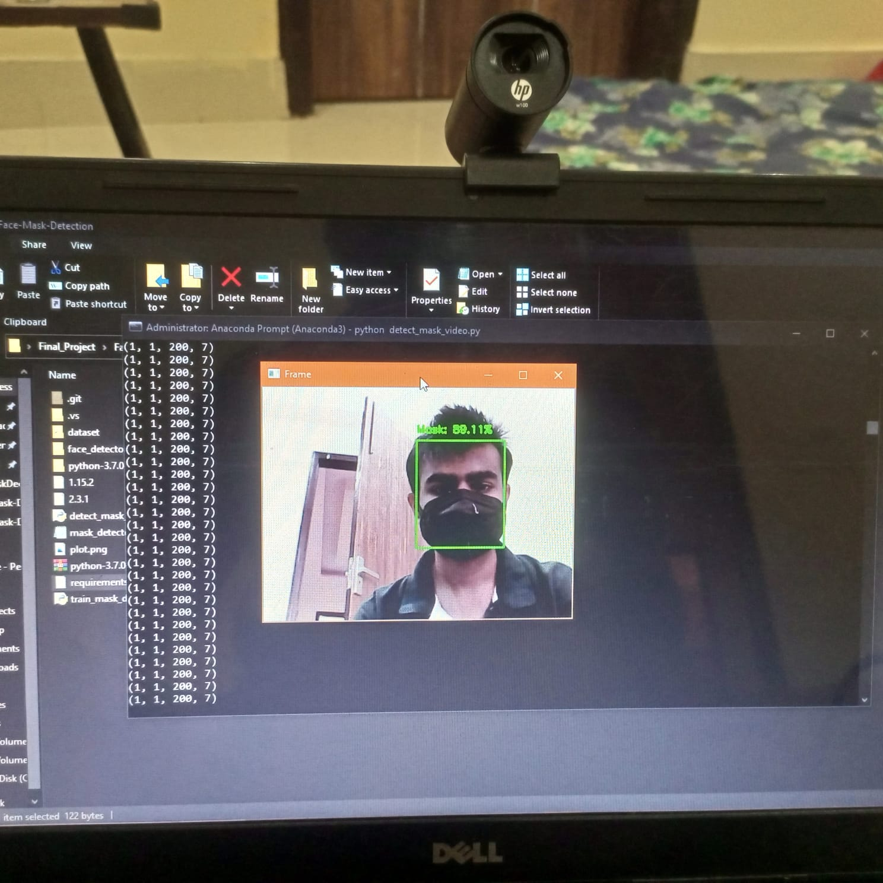
Face Mask Detection via Live Feed
Process Description :
Step 1: First, the dataset is loaded and ID mapping is done where mask and no mask is assigned.
Step 2: Next a tensor flow session is created and the Mask RCNN model is loaded.
Step 3: Then, actual detection of Boxes, Class, Scores and Masks are done.
Step 4: Finally, Instance segmentation is performed and Detection results are visualized.
Fig : Output of Image Segmentation

Slide 17
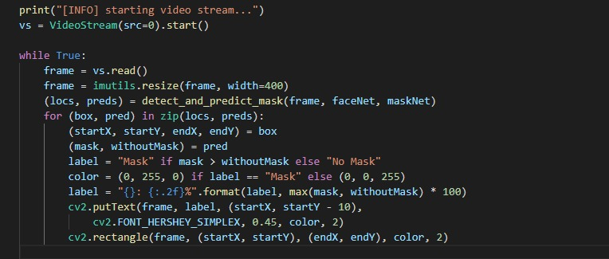
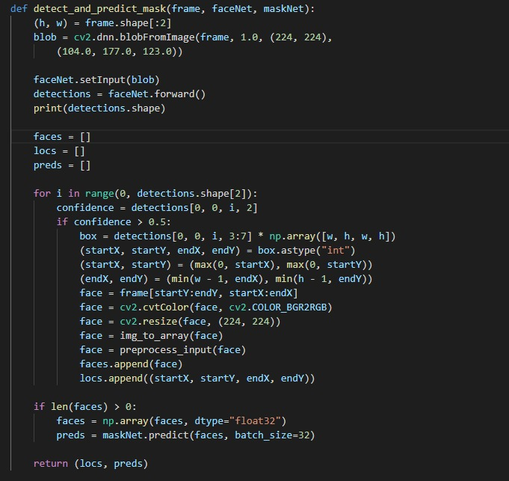
Code Snippet

Slide 18
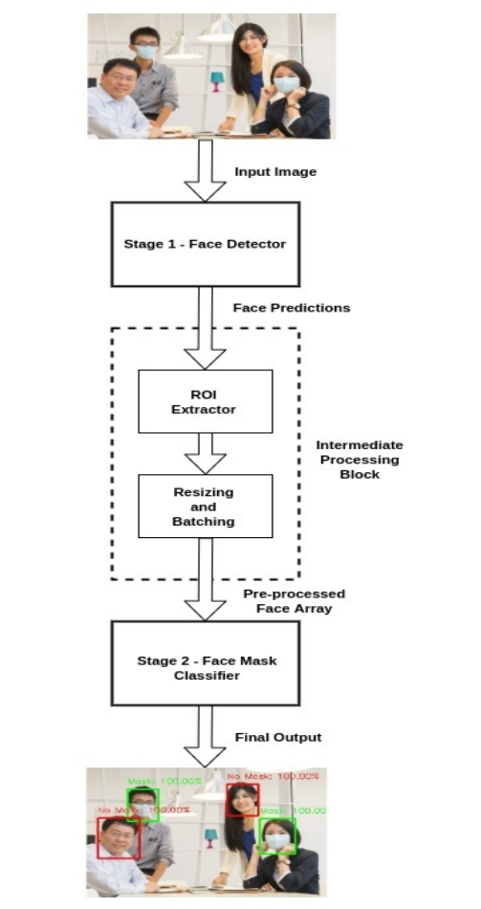
System Architecture : Face Mask Detection
Fig : System Architecture

Slide 19
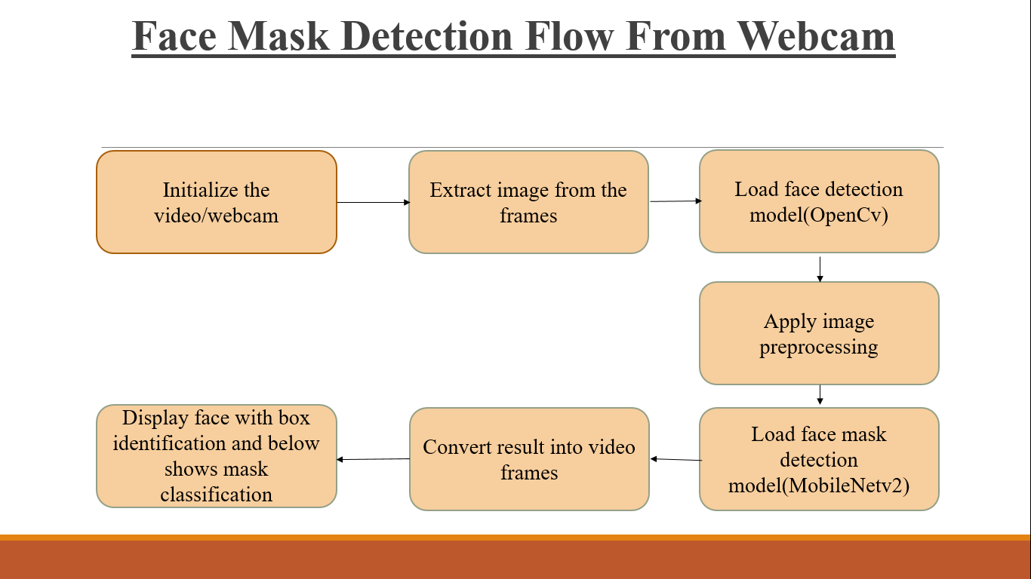
Flow Chart : Face Mask Detection
Fig : Flow diagram for the proposed Face Mask Detection system.

Slide 20
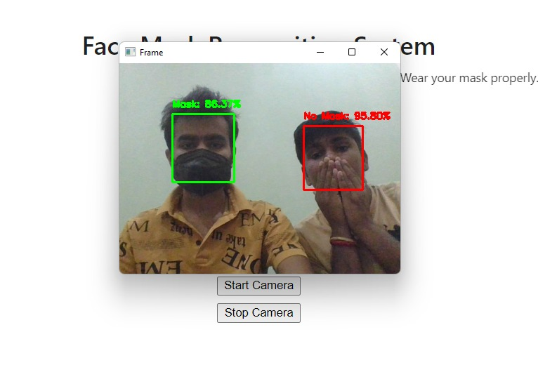
Fig : Frame Classification & Labelled Output as "Mask" or "No Mask"

Slide 21
Front End - User Interface
Voila, an open-source python library that is used to turn the Jupyter notebook into a standalone web application.
Voila converts the Jupyter notebook into HTML and returns it to the user as a dashboard or report with all the inputs excluded and the outputs included.
Here we have created a web app using Voila which is mainly divided into two pages.
Home Page
About Us

Slide 22
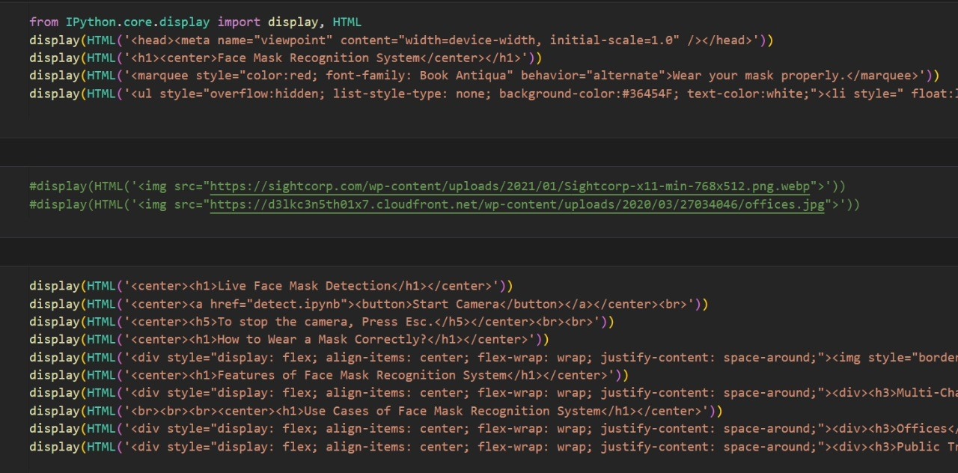
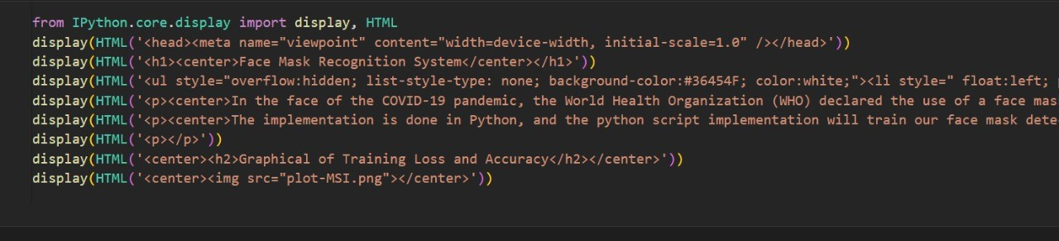
Code Snippet
Fig : Code for Home Page
Fig : Code for About Us Page

Slide 23
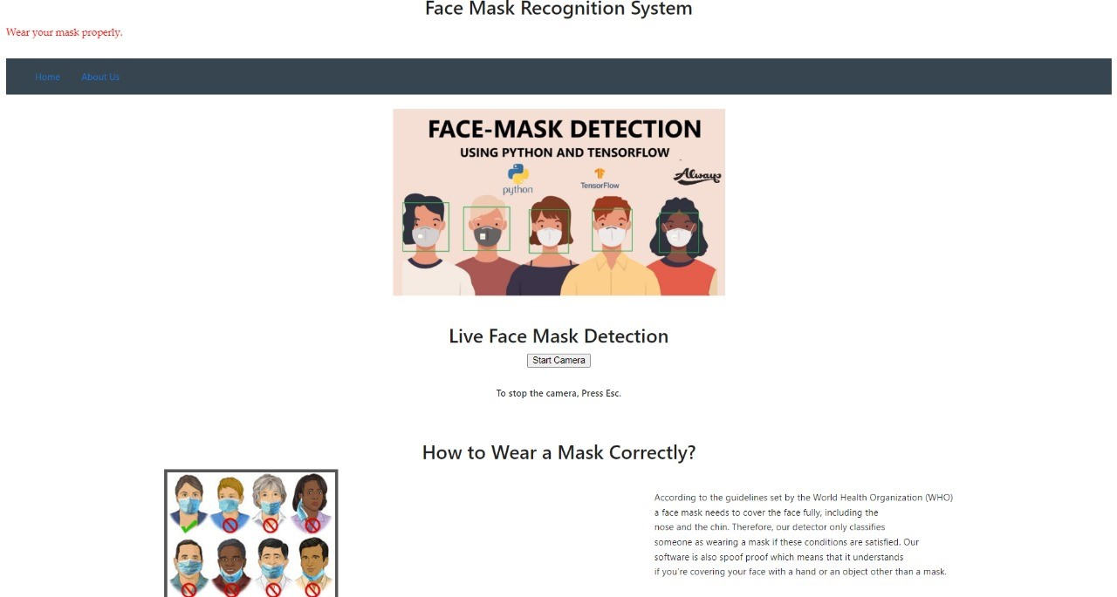
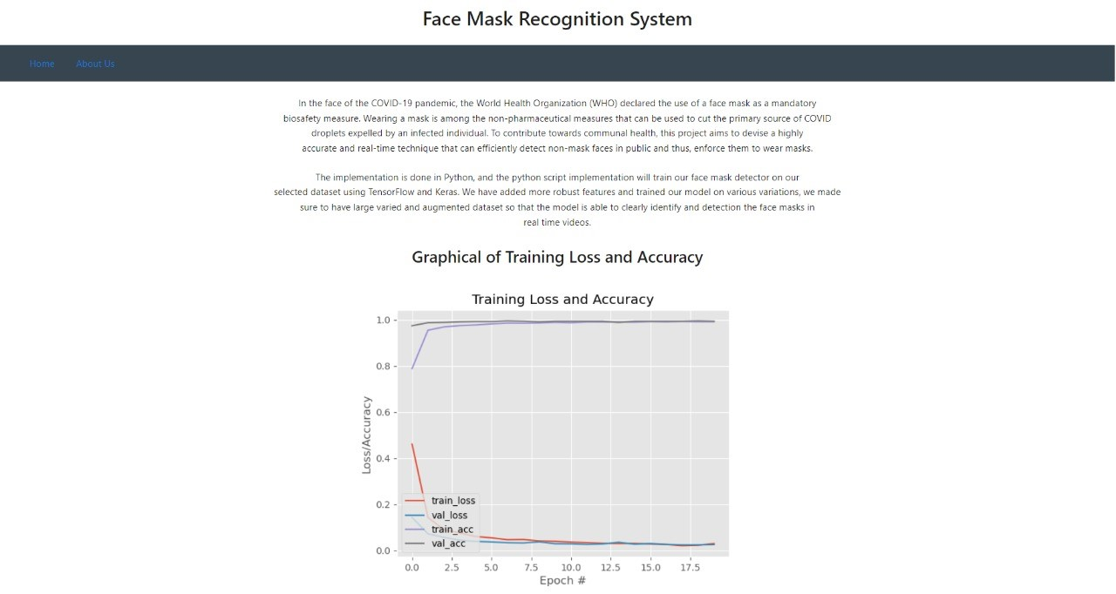
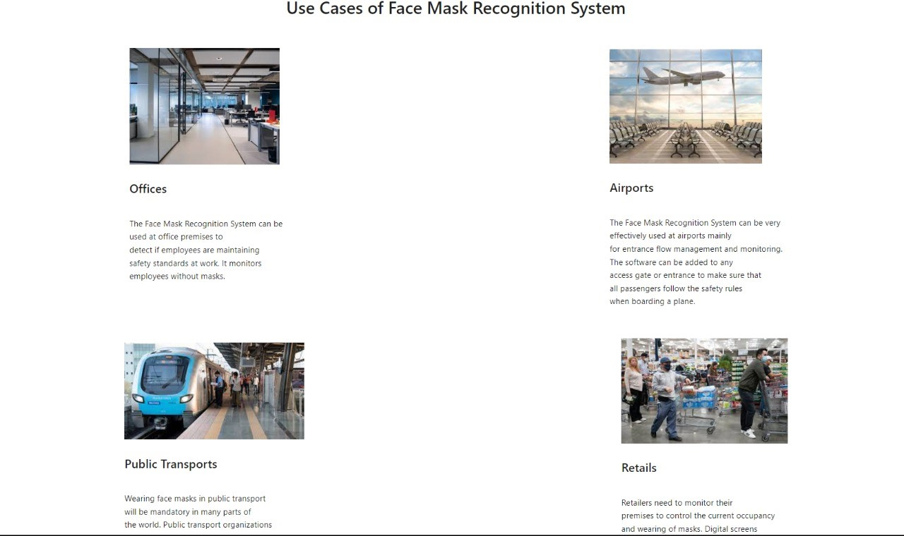
Fig : Home Page
Fig : About Us

Slide 24
Limitations
Highly dependent on camera:
Resolution of camera.
Range of camera.
Visibility of camera in dark environment.
Capacity of camera to monitor large base of crowd.
Can only classify as 0 or 1 i.e. mask worn or not warn nothing in middle.
Cannot identify the credentials of people due to lack of people’s database.

Slide 25
Conclusion and Future Scope
In this work, a deep learning-based approach for detecting masks over faces in public places to curtail the community spread of Coronavirus is presented. The proposed technique efficiently handles occlusions in dense situations by making use of an ensemble of single and two-stage detectors at the pre-processing level. The ensemble approach not only helps in achieving high accuracy but also improves detection speed considerably. Furthermore, the application of transfer learning on pre-trained models with extensive experimentation over an unbiased dataset resulted in a highly robust and low-cost system. The identity detection of faces, violating the mask norms further, increases the utility of the system for public benefits.
Finally, the work opens interesting future directions for researchers. Firstly, the proposed technique can be integrated into any high-resolution video surveillance devices and not limited to mask detection only. Secondly, the model can be extended to detect facial landmarks with a facemask for biometric purposes.

Slide 26
Thank You

